Slide 1


The Breakdown and Analysis of Amazon.com
Group Members:
Fahim Muntashir - 2021183642
Tahmidul Alam - 2021819642
Md. Mushfiqur Rashid Marmo - 2021496642

Slide 2
Front-End: Whatever we see on a website is makes up the Front-end of that webpage.
DEFINITION
Back-End: All the unseen processes and request are handled by back-end of the webpage.
Database: All the webpage related data is remotely stored in the database of the website.

Slide 3
Contents
Slides Number
Color Code
Red -> FE
Yellow -> BE
Blue -> FE+BE+DB
Purple -> FE + BE
Green -> BE + DB
Dark-blue -> DB
Orange -> FE + DB
Fahim Muntashir 4-6
Tahmidul Alam 7-9
Mushfiqur Rashid Marmo 10-12
URL 1 : https://www.amazon.com/
URL 2 : https://www.amazon.com/HP-24mh-FHD-Monitor-Built/dp/B08BF4CZSV/ref=lp_16225007011_1_4
URL 3 : https://www.amazon.com/s?i=specialtyaps&rh=n%3A468642&ref=nav_em__nav_desktop_sa_intl_kids_family_0_2_26_19

Slide 4
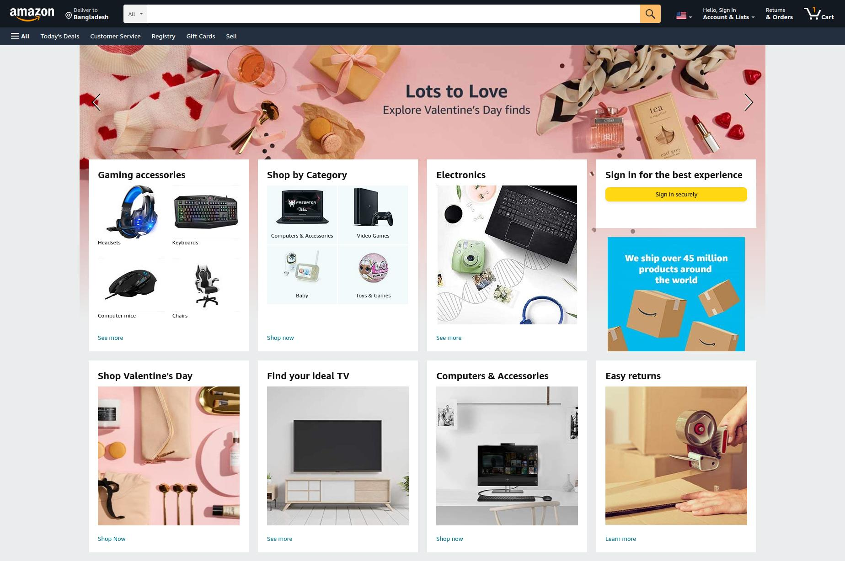
Amazon Logo and the other portion are clickable and redirect to another pages. So it’s Back-end
The carousel slider is Front-end and it’s clickable. So Back-end also.
It’s functional and here all the data comes from Database using Back-end.
It’s just use the html heading tag. So it’s only Front-end
All the images grid view using Front-end and the Data comes from Database using Back-end.
It’s clickable and redirect to another page. So it’s Back-end.

Slide 5
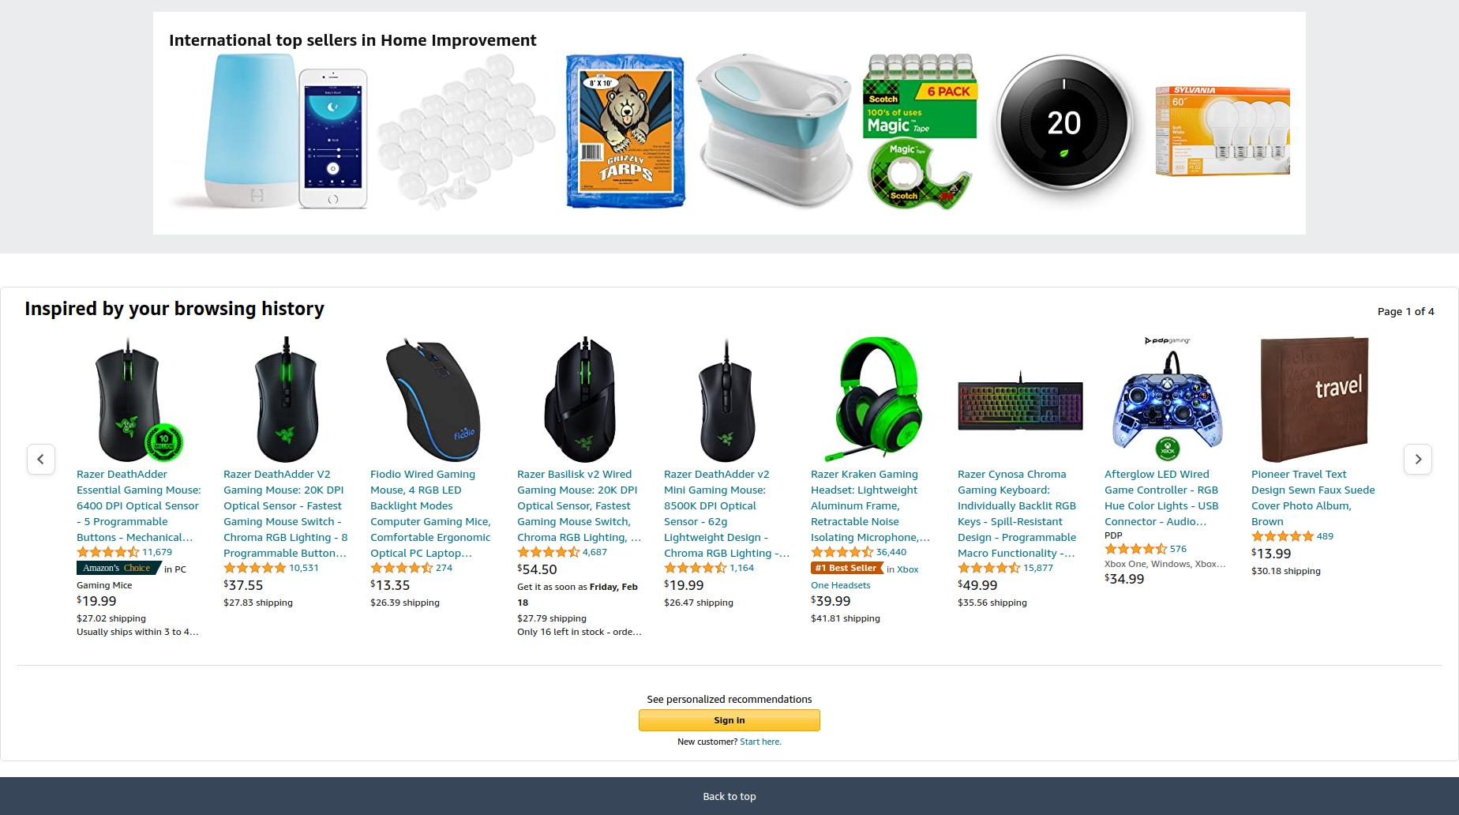
It’s Front-end because here only uses Heading tag.
The pagination details comes from Database and the design is Front-end
The images grid view is from Front-end and the images are clickable. So it’s Back-end too.
slider button and the heading tag all comes from Front-end
Image Details and Sign in section is from Database and it redirects to another page. So it’s Back-end and Database.

Slide 6
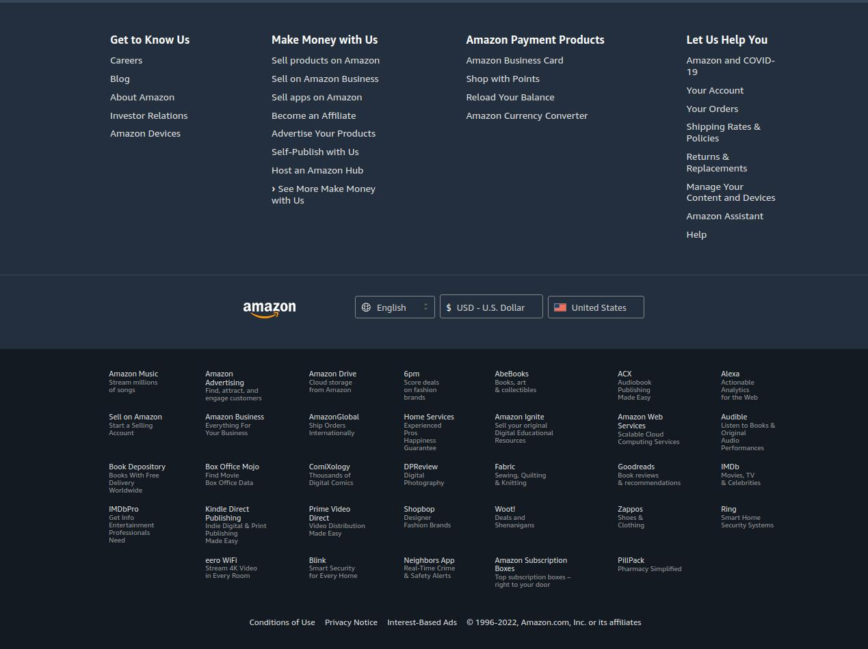
here the language, currency and country data is coming from server. So it’s Back-end and Databae.
here only use the html heading tag . So it’s only Front-end
here the footer tag is not clickable. So it’s Front-end
here Amazon and the other section is clickable and it redirects to their sub company. So it’s Back-end only.

Slide 7
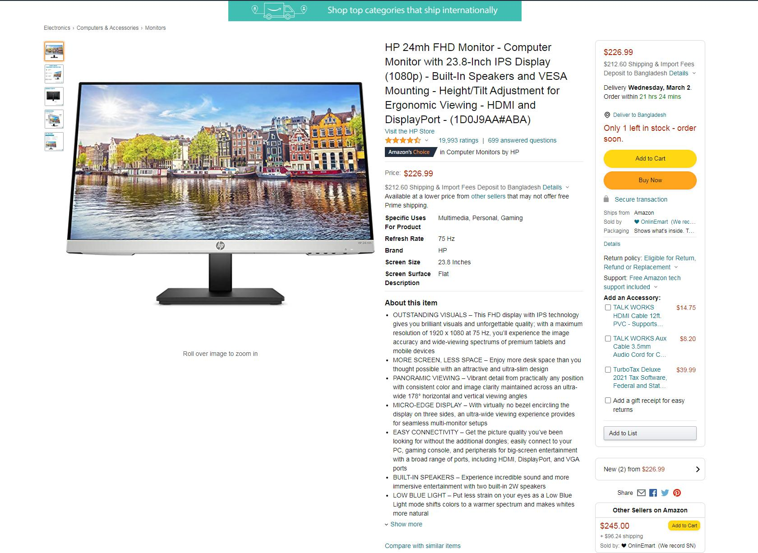
It’s just heading and not clickable. So it’s only Front-end.
The monitor part and the product details paragraphs are Front-end. the ratings and price comes from Database using Back-end
Clickable link containing images from Database thus being Back-end and Database.
It’s clickable and redirects to another page. So it’s only Back-end.
The share link redirect to each social media. So it’s Back-end and the design comes from Front-end.

Slide 8
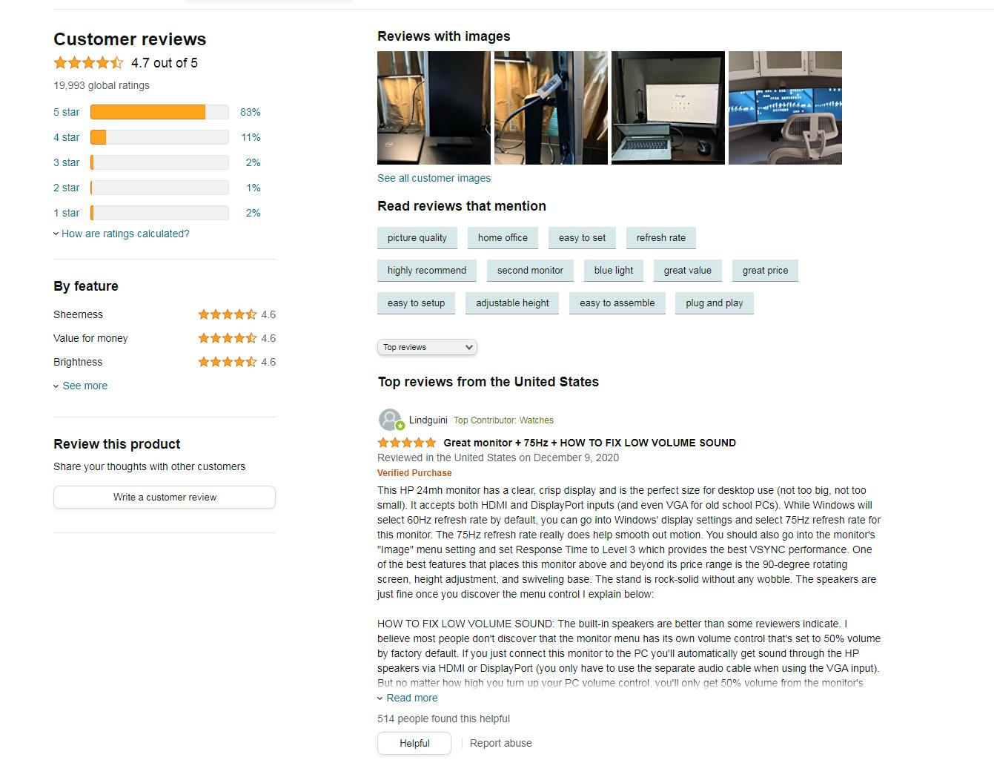
these are the heading of the html. So it’s only Front-end.
Images grid view is from Front-end, the images are shown from Database and because of the clickable it Back-end too.
Ratings are calculated using various information Database using Back-end.
customer reviews are saved from here with the help of Back-end and Database.

Slide 9
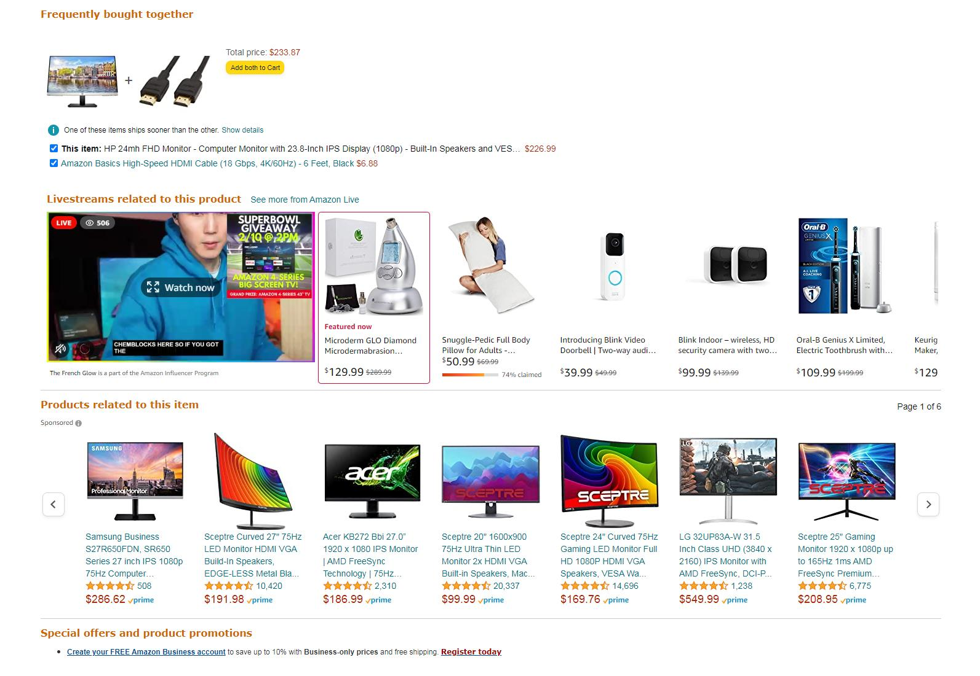
It’s just heading and not clickable. So it’s only Front-end.
All the images grid view using Front-end and the Data comes from Database using Back-end.
This images and hardware specifications are shown here from Database using Front-end.
It’s functional and here all the data saved in Database using Back-end

Slide 10
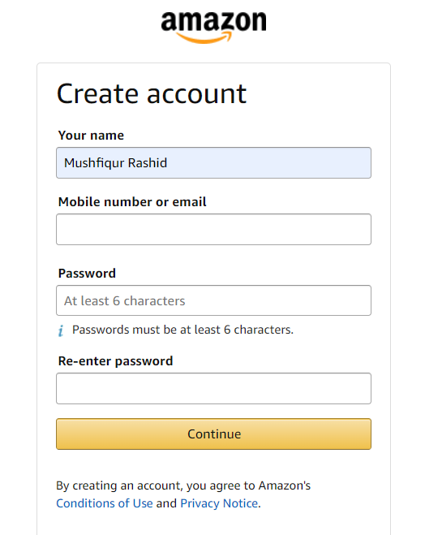
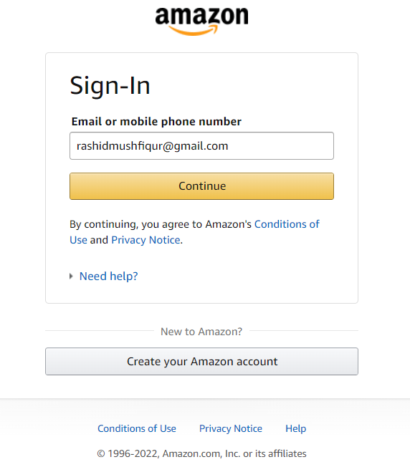
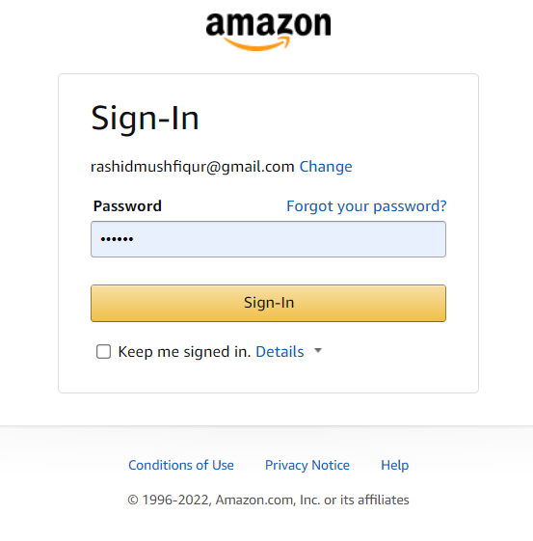
These are headings and paragraphs and also non clickable. So it’s only Front-end.
These are clickable and connected with Database using Back-end
Amazon Logo and the other portion are clickable and redirect to another pages. So it’s Back-end

Slide 11
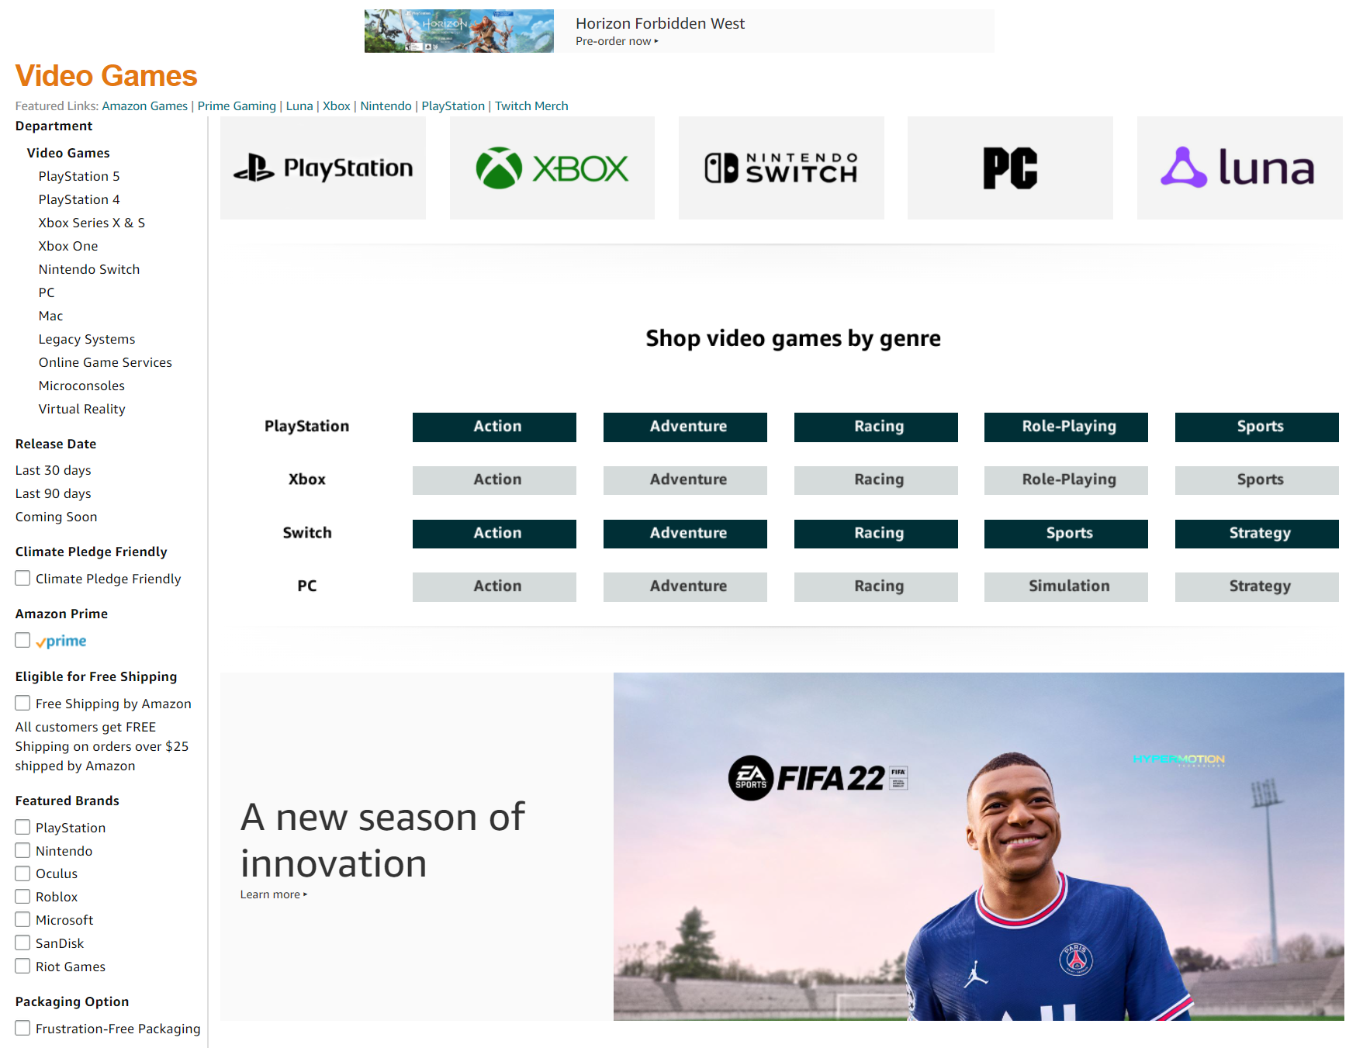
these are clickable (ad) . That’s why Back-end only
It’s just heading and not clickable. So it’s only Front-end.
This is Front-end and it’s clickable. So Back-end also.
All the clickable names are fetched from Database using Back-end and are shown here using Front-end

Slide 12
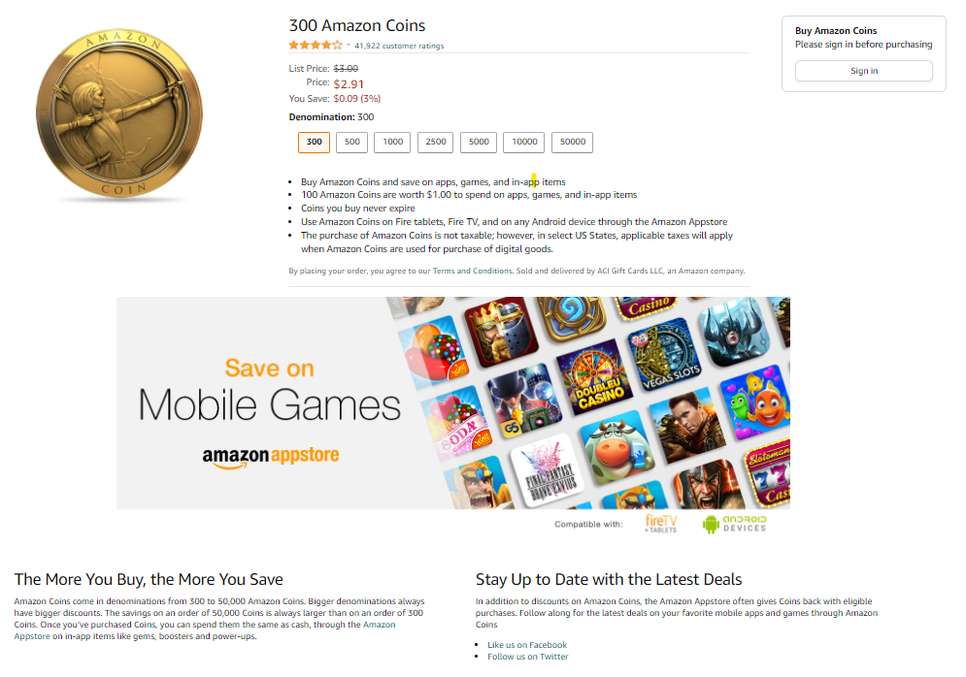
Price and other clickable are fetched here from Database using Back-end and shown here using Front-end
Sign in section is from Database and it redirects to another page. So it’s Back-end and Database.
These images and the header tags and other stuffs using Front-end only
These are clickable and redirect to another pages. So it’s Back-end

Slide 13
END
…………………………
THANK YOU
Notes:
<number>

